Slide 1
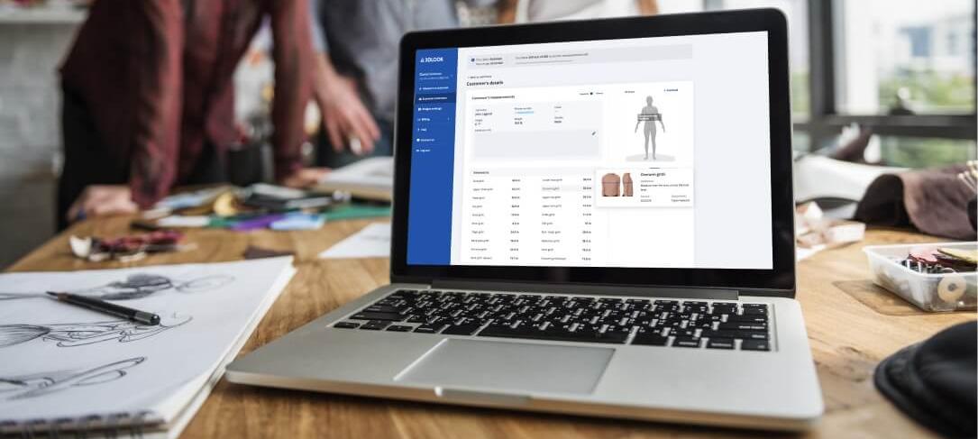
VIRTUAL CLOTHING SYSTEM
virtual fitting and styling solution

Slide 2
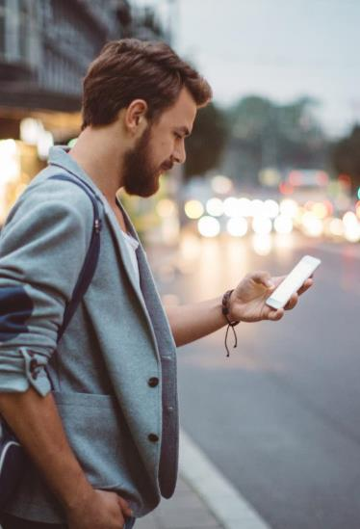
Abstract
Users that shop for clothes online need to select the appropriate clothing size from available options. This can pose a problem since different brands define sizes (e.g., small, medium, large, etc.) differently.
This disclosure describes techniques that enable a user to measure body dimensions relevant to clothing size, e.g., chest, waist, inseam, etc., based on capturing images of the user.
The techniques can be implemented using the camera and the browser of the user’s device, such that clothing-size measurement and trial it to the model on clothing, style outfits and find their perfect fit.
Which will reduce returns and elevate your e-commerce experience

Slide 3
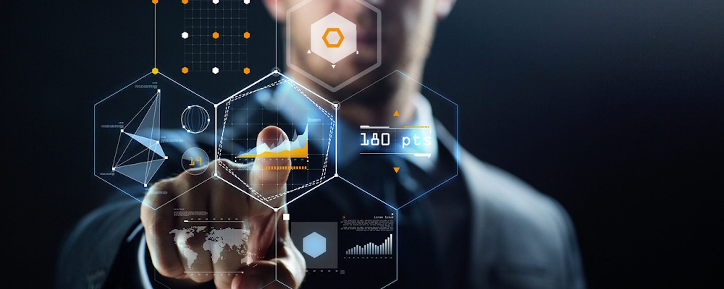

Objectives
We built web-base body scanning and measuring technology which enables to measurement of their body , get right size clothes and apply body data to wearing clothes virtually which will reduces time by having virtual trail instead of having a real trail for clothes.
The project providing a contactless and personalized fit experience for consumers, drive down returns and inventory, and apply body data to the apparel supply chain to create a more sustainable business model to help optimize processes, cut costs, and deliver better shopping experiences
Let your customers try on clothing, style outfits and find their perfect fit . Boost conversions, reduce returns and elevate your e-commerce experience

Slide 4
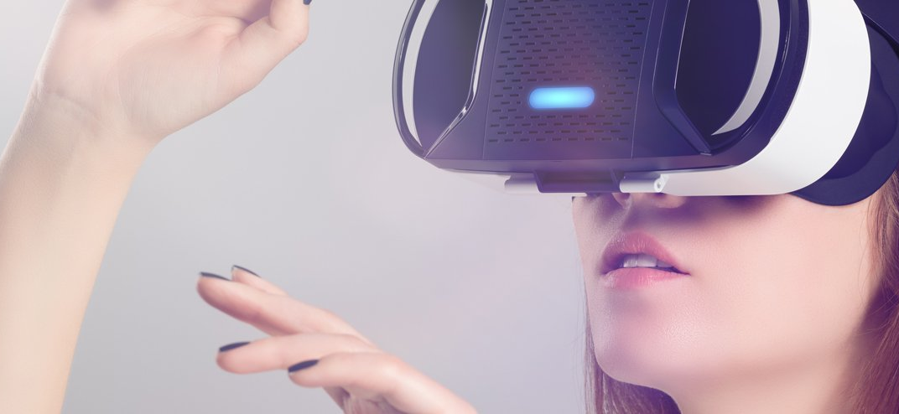
Existing System
Body Measurement app
Although there is many app available based on Virtual Reality ( VR ) augmented reality (AR) like GAP Inc which will measure body size .But main disadvantage is that the user should download , installation, configuration, and activation by the user, which adds to and *the number of steps needed to finalize a purchase. More over that ever user does not have device which support AR or VR technology
More over that every user does not have device which support AR or VR technology ,which may be big reason that thought app are still not comes to market and not know by many people .
In additionally VR need hardware required like VR Kit

Slide 5
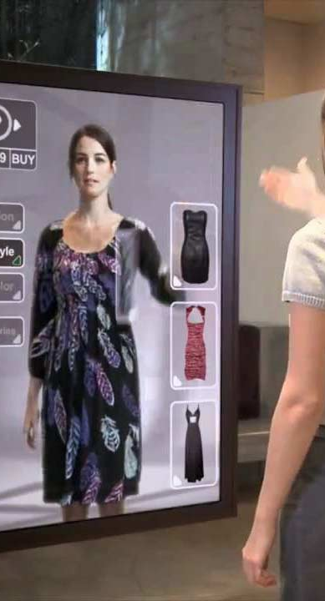

Proposed System
To over come the above problem We are built web-base body scanning System which mean platform independent so android , IOS ,Windows ,Linux ,mac etc., user can use it by just few clicks.
More over we create a model which have same size and color of the user to wear the cloth’s virtually , Which will help the user to get an rough Idea How he/she will look after they wear it.
Over 37% of return can be minimize by our proposed system which mean in e-commers business of cloth the user was return the product due to size barrios and the design of cloth was not suit for them .
Another benefit over the Existing System is that every time the uses should take the phot which make him uncomfortable ,But in proposed system use store their data once and used for many time.
Due to virtual trial the cloth are maintain hygienic , which lead to minimize the spread of infection or virus especially corona virus .

Slide 6
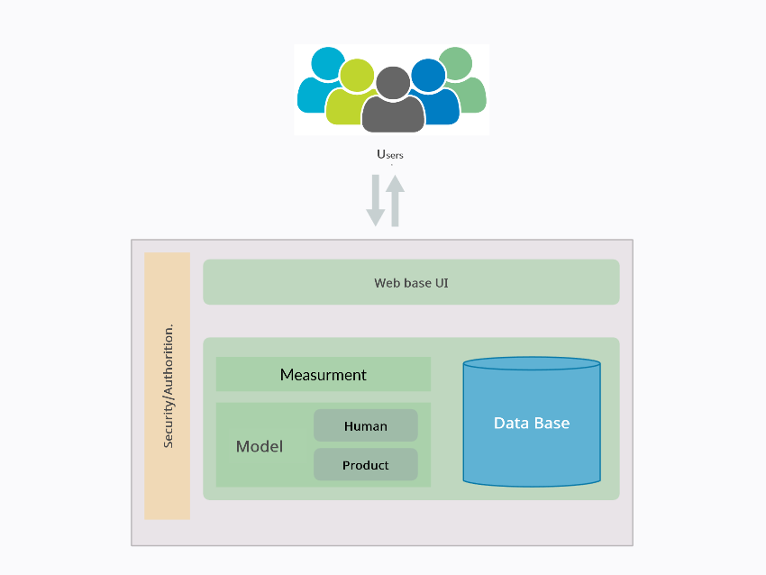
Architectural Design for Proposed System

Slide 7

Modules Split-Up
1
Login
2
Gather Measurement ( Manually , RCM [Scanning])
3
Create Model (Human ,Product)
4
Virtual trial

Slide 8

Algorithms
BodyPix uses the convolutional neural network algorithm. We trained both a ResNet model and a MobileNet model. Although the ResNet based model is more accurate, this post concerns the MobileNet one which has been open-sourced for its ability to run efficiently on mobile devices and the standard consumer computers.
At the core of BodyPix is an algorithm that performs body segmentation — or, in other words, performs a binary decision for each pixel of an input image to estimate whether that pixel belongs to a person or not
To estimate the body part segmentation, we use the same MobileNet representation, but this time repeat the above process by predicting an additional twenty-four channel output tensor P where twenty-four is the number of body parts.
Data Structure Techniques used with complexity
We using Body pix which is real-time person and body part segmentation in the browser using TensorFlow.js.

Slide 9
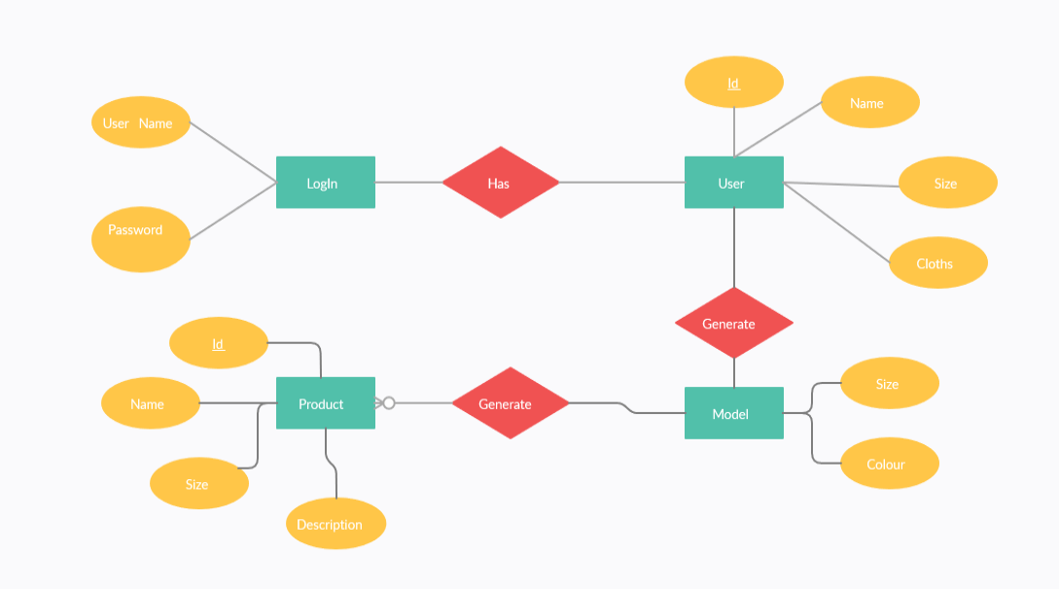
ER Diagram

Slide 10
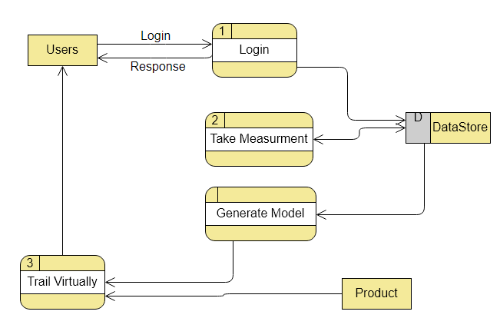
Data Flow Diagram (DFD)

Slide 11
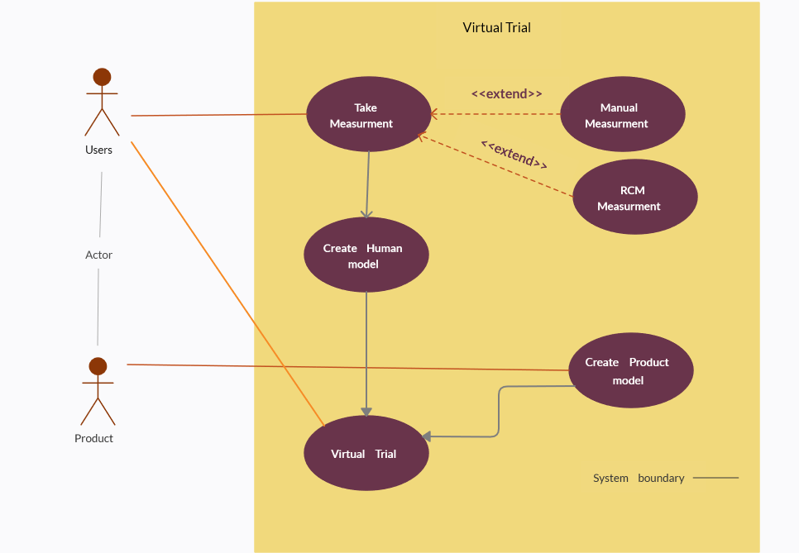
Use Case Diagram

Slide 12
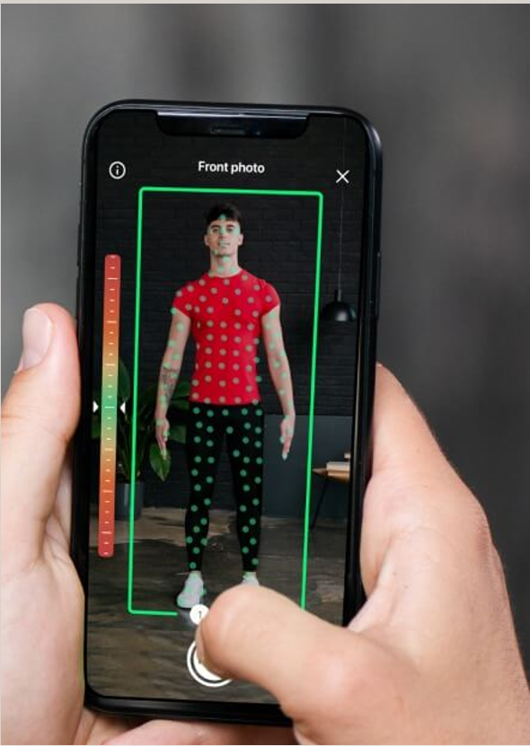
Expected Outcomes
The final output expecting as a 3d model of user with perfect outfit virtually .
Input
Process
Output

Slide 13


30 % Code Implement

